Slide 2
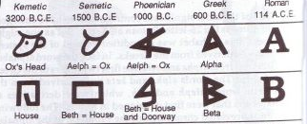

Slide 3
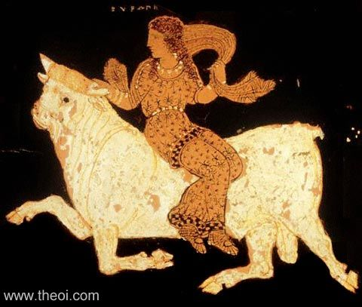
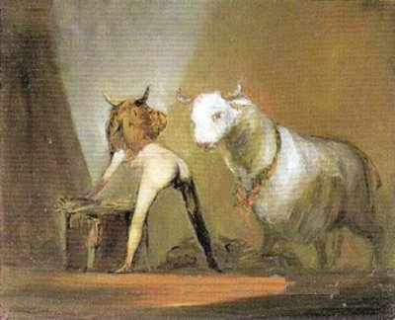

Slide 4
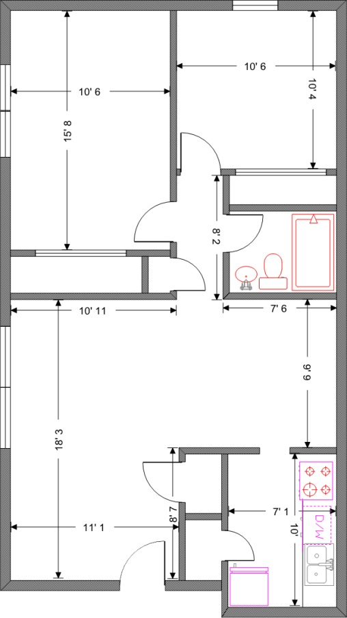

Slide 5
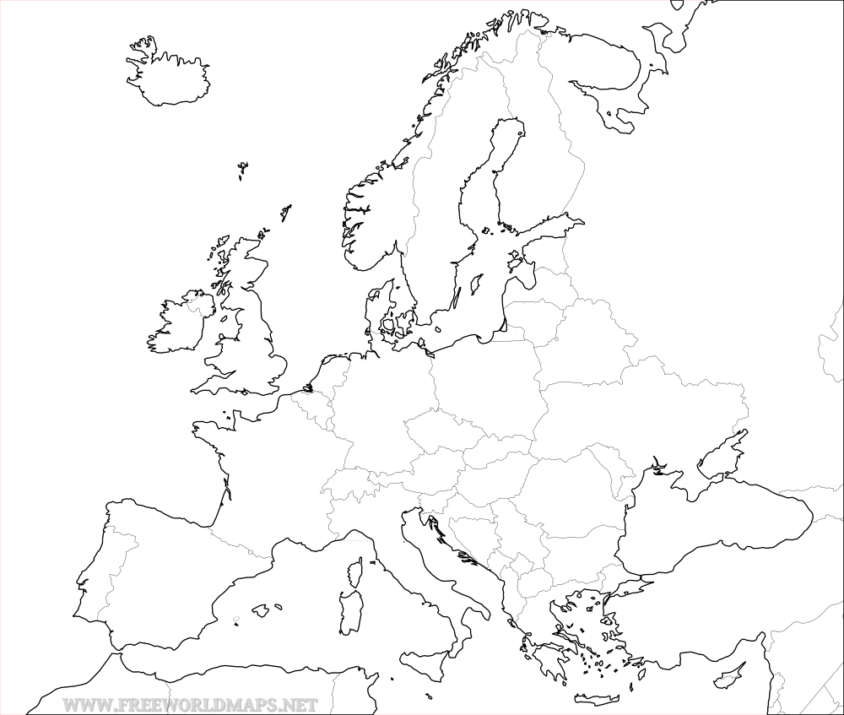
Old core: The horizon of Herodotus
Europe as Eastern-Mediterranean coastlands

Slide 6
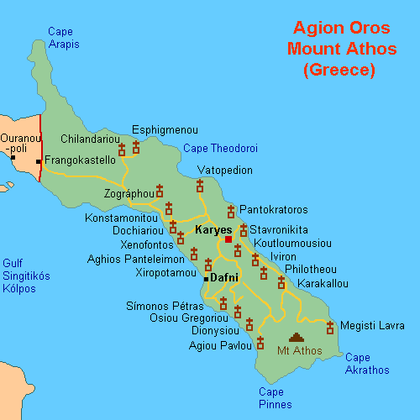
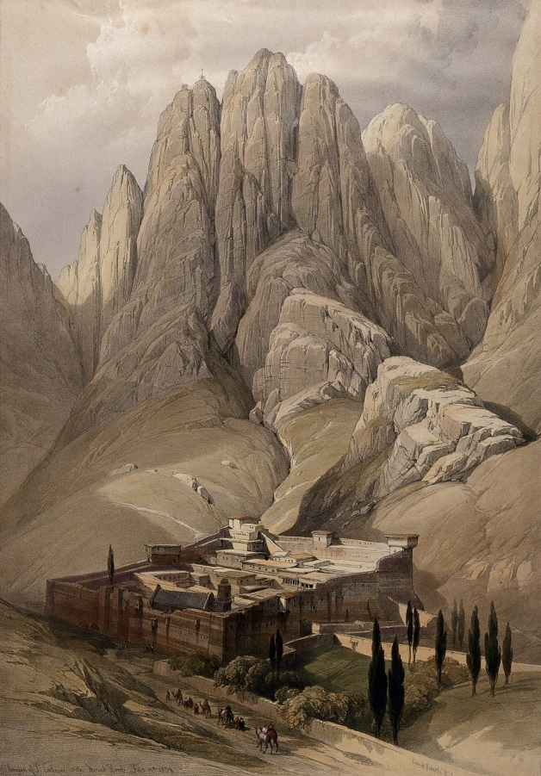
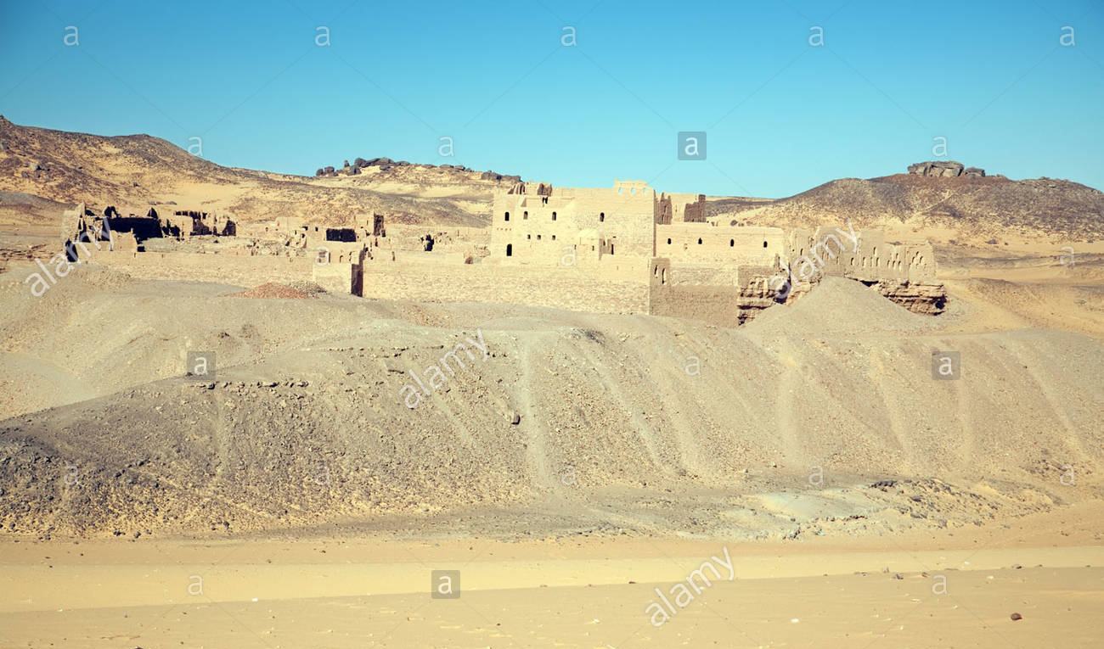
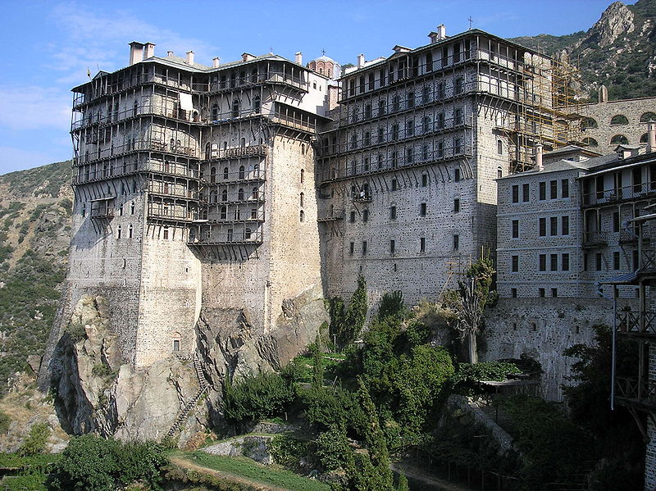

Slide 7
The Condensation of Europe, 700-1700

Slide 8
Inner horizon: Judaeo-Classical Christendom Europe
Opposed to Islam, “Barbarians”.

Slide 9
732 slag van Poitier/Tours: Karel Martel, vader van Pepijn de Korte en grootvader van Karel de Grote, verslaat de legers van Abdul Rahman.
De monnik Notker van Sankt-Gallen beschrijf dit als een overwinning van de europenses, de Europeanen.
1454: Enea Silvio Piccolomini (de latere paus Pius II) reageert op de inname van Constantinople tijdens de Rijksdag van Frankfurt:
We moeten de waarheid onder ogen zien dat de Christenheid in vele eeuwen geen grotere smaad heeft moeten verdragen dan thans. Vroeger vonden onze nederlagen plaats in Azië en Afrika, in verre landen. Maar nu zijn wij verslagen in Europa, in ons eigen vaderland, in ons eigen huis, in onze eigen woonplaats.

Slide 10
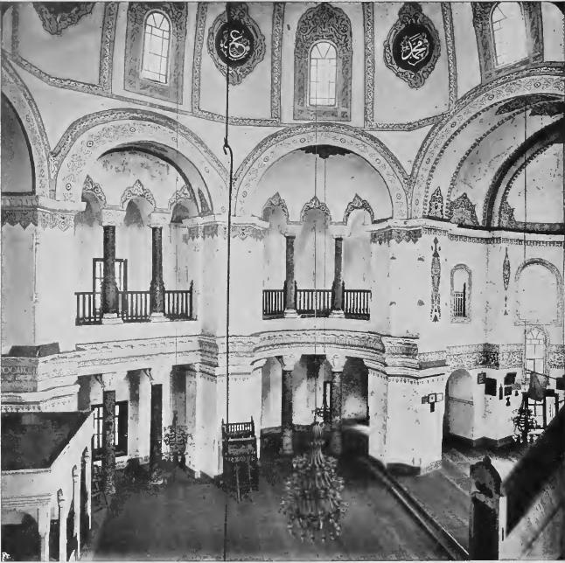
Church of SS Sergius
and Bacchus (c. 530 AD,
now Küçük Ayasofya
Camii - photograph 1914)

Slide 11
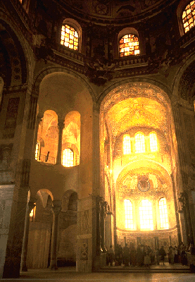
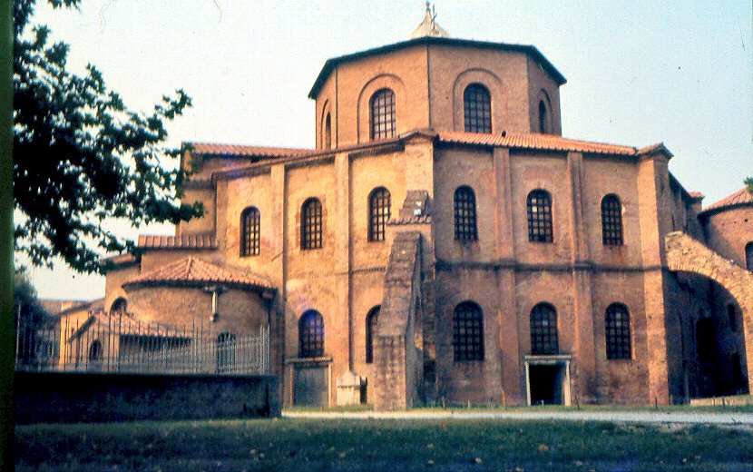
Church of San Vitale, Ravenna
(530-540 AD)
Ravenna:
capital of Ostrogothic kingdom ,
conquered by Belisarius in 540,
Byzantine exarchate until 751
Longobardic conquest 751
Pepin ousts Longobards 756
donates Ravenna to Roman pope
Pepin:
son of Charles Martel
King of the Franks 751-768
father of Charlemagne

Slide 12
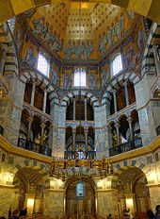
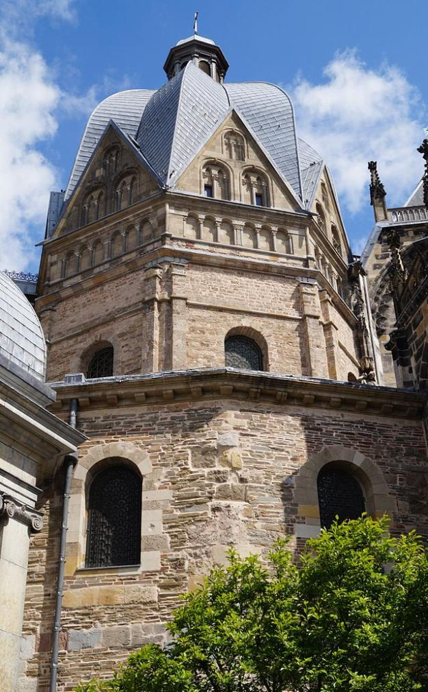
Aachen basilica (796-805)
built as palace chapel by Charlemagne
highest building north of the Alps untill 1000
Charlemagne :
son of Pepin, grandson of Charles Martel
Kings of the Franks
crowned Emperor of the West by the Pope, 800.

Slide 13
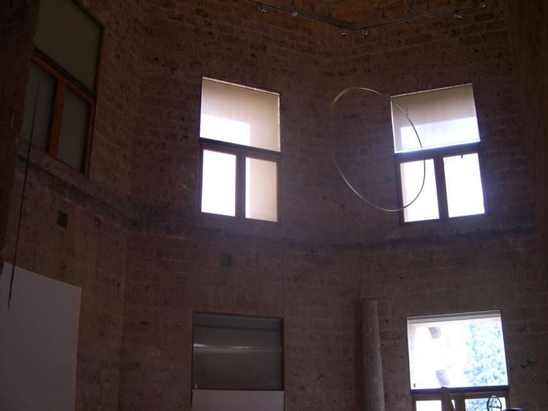
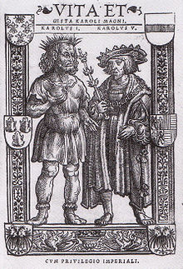
Chapel of Palace of Charles V,
Alhambra, Granada (1526)
Charles V:
Crowned King of the Germans in Aachen basilica in 1520
Spent honeymoon Isabella of Portugal in Alhambra in 1526
Crowned Holy Roman Emperor by the pope in 1530
Founds university in Granada in 1526/31
Strongly conscious of his succession to Charlemagne
medieval life of Charlemagne,
Cologne 1521 printing

Slide 14
5 battles, 4 octogons, 3 Charleses
732: Battle of Tours
Charles Martel defeats
Abd ar-Rahman
751: Pepin takes Ravenna
from warring Byzantines
and Longobards
1452: Mehmet II takes
Constantinople
711: Tariq ibn-Zayid crosses into Spain from al-Andalus;
1492: Fall of Emirate of Granada

